Slide 1
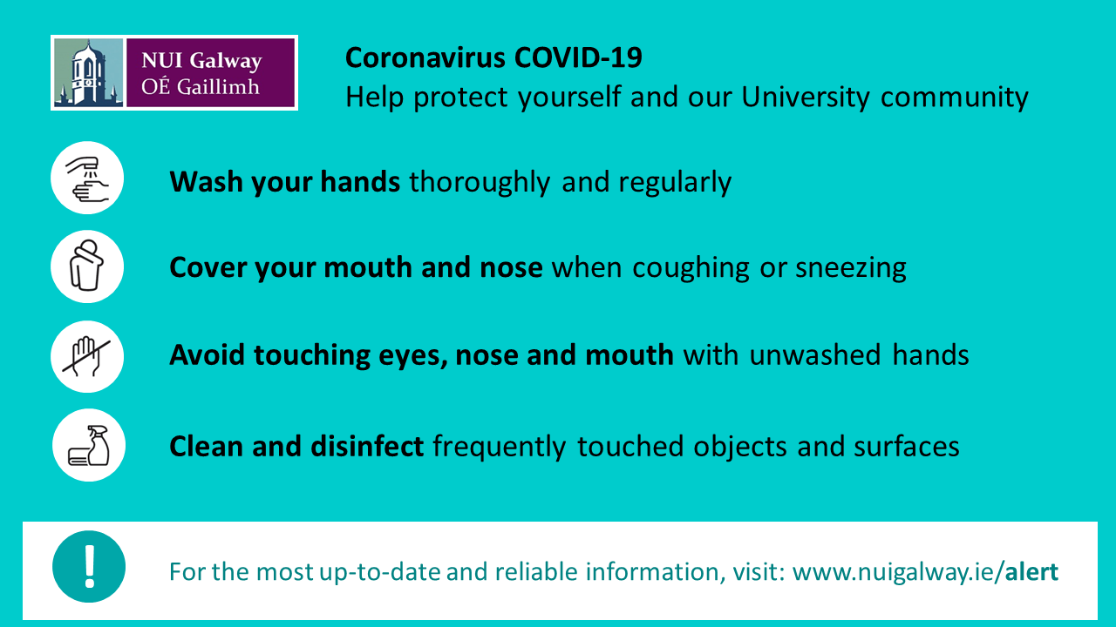
Ground rules

Slide 2
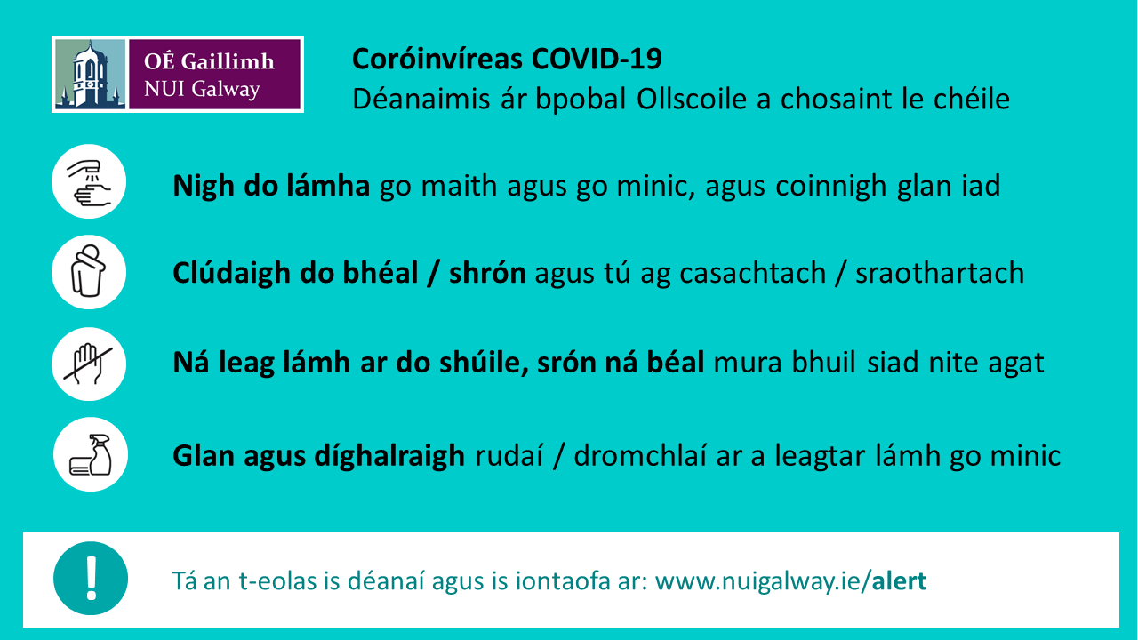
Ground rules

Slide 3


Slide 4
MCMCglmm for comparative analysis and for data imputation

Slide 5

Yesterday we ran into the problem of non-independent data.
y
x₁

Slide 6
Really common problem in Biology
y
x₁

Slide 7
Random effect
y
We are assuming that data points within each group are equally related
x₁

Slide 8
Random effect
y
We are assuming that data points within each group are equally related
x₁

Slide 9
Kingdom Phyla Class Order Family Genus Species Population individual

Slide 10
Nested
y
Red points more related to each other than all other points but two groups also within red.
x₁

Slide 11
We can imagine these as groups. However there is lot more information in there. Its hierarchical and continuous

Slide 12
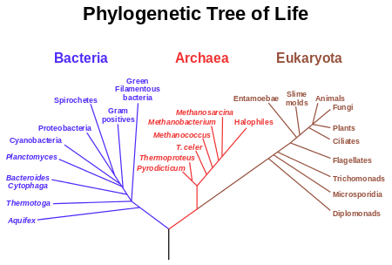

Slide 13
http://www.onezoom.org

Slide 14

Build a phylogeny

Slide 15
Use the distance between species

Slide 16
Speciation
Present

Slide 17
Assume evolution is a Brownian walk
Speciation
Traits evolution
Present
Present

Slide 18
Use distance on phylogeny
y
x₁

Slide 19
Use distance on phylogeny
y
x₁

Slide 20
Lynch et al 2007

Slide 21
Lynch et al 2007

Slide 22
Use distance on phylogeny
y
x₁

Slide 23
Variance co-variance matrix
10
10
10
10

Slide 24
Variance co-variance matrix
4
10
4
4
10
10

Slide 25
Variance co-variance matrix
2
10
4
2
4
10
2
2
2
10

Slide 26
y = Xβ + Zu + e
Zu is now a VCV
10
4
2
4
10
2
2
2
10

Slide 27
Assume Brownian motion
y = Xβ + Zu + e
Zu is now a VCV
10
4
2
4
10
2
2
2
10

Slide 28
Pagels lambda
10
4
2
X λ
4
10
2
2
2
10

Slide 29
Pagels lambda
λ = 1
10
4
2
X 1
4
10
2
2
2
10

Slide 30
Pagels lambda
λ = 0
0
0
0
X 0
0
0
0
0
0
0

